Slide 1

GIS 5572 Cole Anderson

Slide 2
Problem
Distance is not the only movement concern for pedestrians with mobility difficulties. A short distance with a steep slope will take as much energy as a long distance gradual slope. Create a code interface that finds the route with the lowest total “energy” cost between any two network points for eventual web app integration.

Slide 3
Data
MN GeoSpatial Commons Road Centerlines (GACS)
Includes roadlines for Anoka, Carver, Chisago, Dakota, Hennepin, Isanti, Ramsey, Sott, Sherburne and Washington counties.
NAD83 UTM 15 in meters
MN Geospatial Commons Minnesota Digital Elevation Model: 30m
USGS 1:24000 Level 2 DEM
NAD83 UTM 15 in feet (vert.) and meters (horiz.)

Slide 4
Methods: 1
Calculations
Find street elevations from DEM
arcpy.AddSurfaceInformation
Zmax & Zmin
Data Retrieval
Standardize Units
Convert roadlines from meters to feet
CalculateField_management
Create feature dataset
GDB Import
Find Slope & Energy Cost
Slope = (Zmax-Zmin)/Leng_FT
Energy = Slope*Leng_FT

Slide 5
Methods: 2
Solver
Route Solver
Create ND_layer from network
Add input/stops layer
Initialize arcpy.nax.Route
Set solver properties
Travel Modes
Time/Accumulation
Directions
Route.solve
Solver
Create Network and Travel Mode
arcpy.na.CreateNetworkDataset
Travel Mode: use Energy for impedance
Create layer with start/end points
Cursor inserts user defined points in new FC

Slide 6
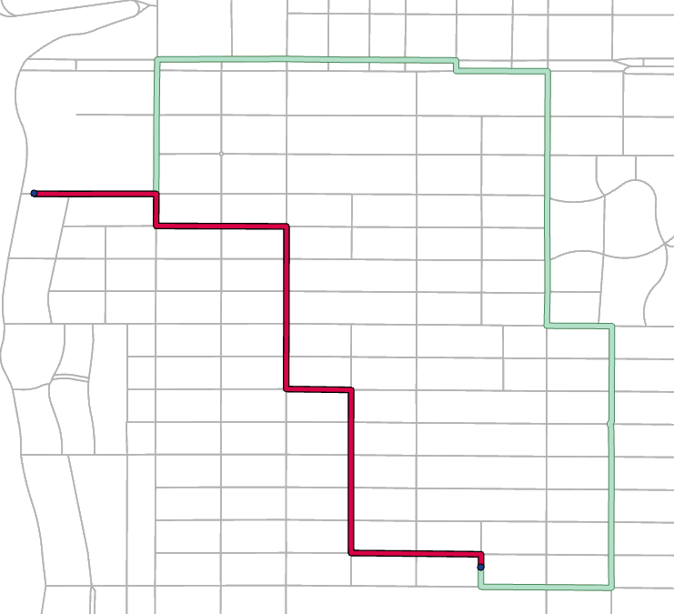
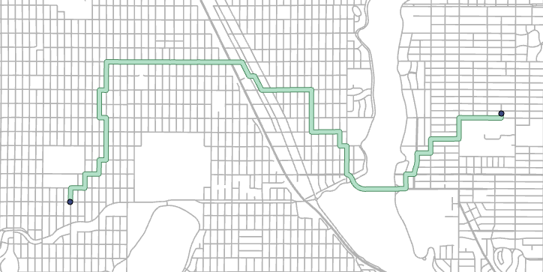
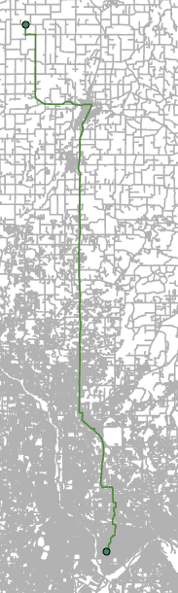
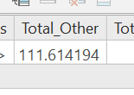
Results
Lowest Energy
Shortest Distance

Slide 7
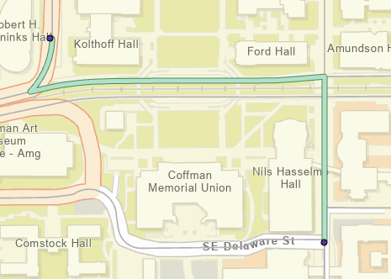

Slide 8
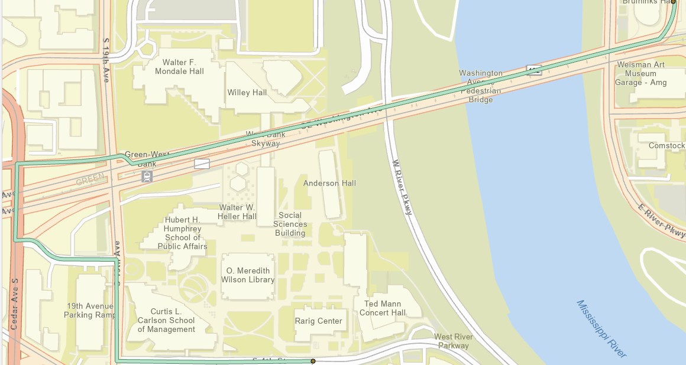
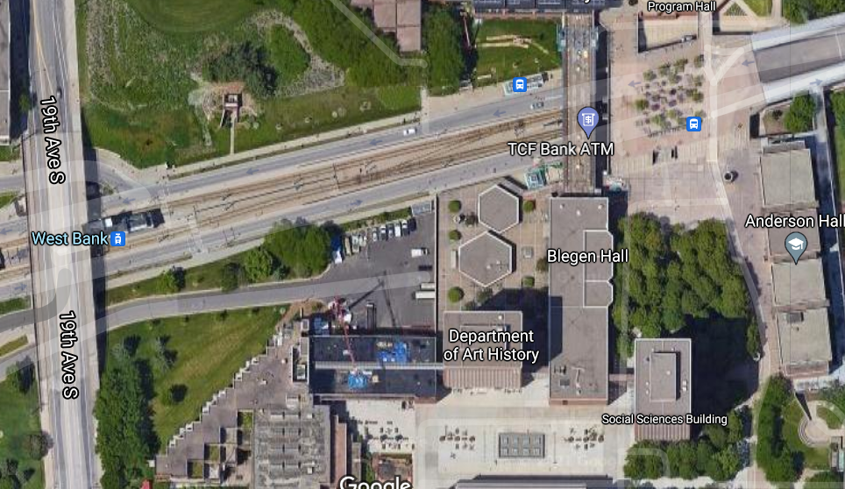
PED
PED
CAR

Slide 9
Result evaluation
Is the algorithm delivering the LEAST ENERGY route?
Unsure about testing this exactly (heuristically is ok)
Length should be >= shortest distance route
Energy should be <= shortest distance route
10,305.53 m (343.48 E) vs 8,418.63 m (380.12 E)
Is this route feasible for PEDESTRIANS?
I.e., that last route across Washington Ave. Bridge
Interstate w/o sidewalks, same level (calculating as ‘car’)
2000 barriers exceeded issue

Slide 10
Conclusion
Network quality is good
Some routes are inaccurate despite correct vertical connectivity
We cannot assume all roads have accompanying and similar sidewalks. The algorithm is still running on only the roads, effectively a vehicle
Uses elements of routing, ETL, table data modification
Would like to add just a general map that shows E-cost of each street in different colors
Can the energy formula be improved to reflect needs?

